Slide 1

Data Science
EEL4930 Data Science for ECE
Spring 2020

Slide 2
Instructors
Instructor: Dr. John Shea
Professor
Electrical & Computer Engineering
Office: NEB 439
Office Hours: TBD
Instructor: Dr. Catia S. Silva
Lecturer
Electrical & Computer Engineering
Office: NEB 467
Office Hours: Fridays 10:40 AM – 11:40 AM
Supervised Teacher: Ying Ma
Ph.D. student
Computational NeuroEnginering Lab (CNEL)
Electrical & Computer Engineering
Office: NEB 486
Office Hours: TBD
TA: Pham Quan
[LAB name]
Electrical & Computer Engineering
Office: NEB XYZ
Office Hours: TBD

Slide 3
Prof. Shea

Slide 4
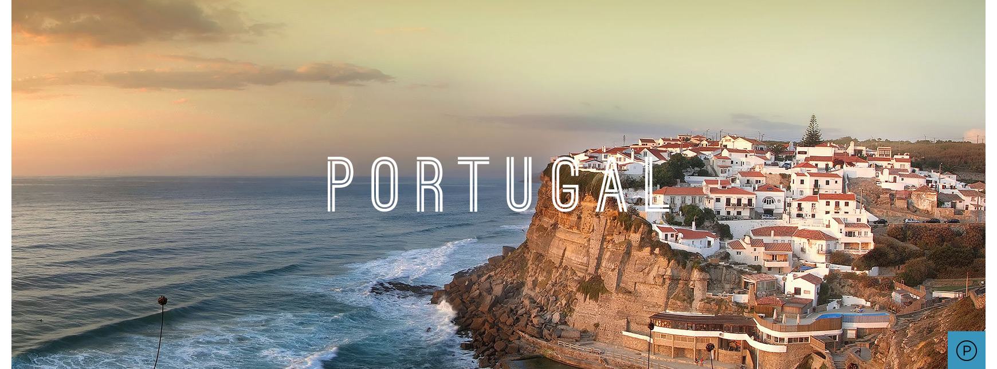
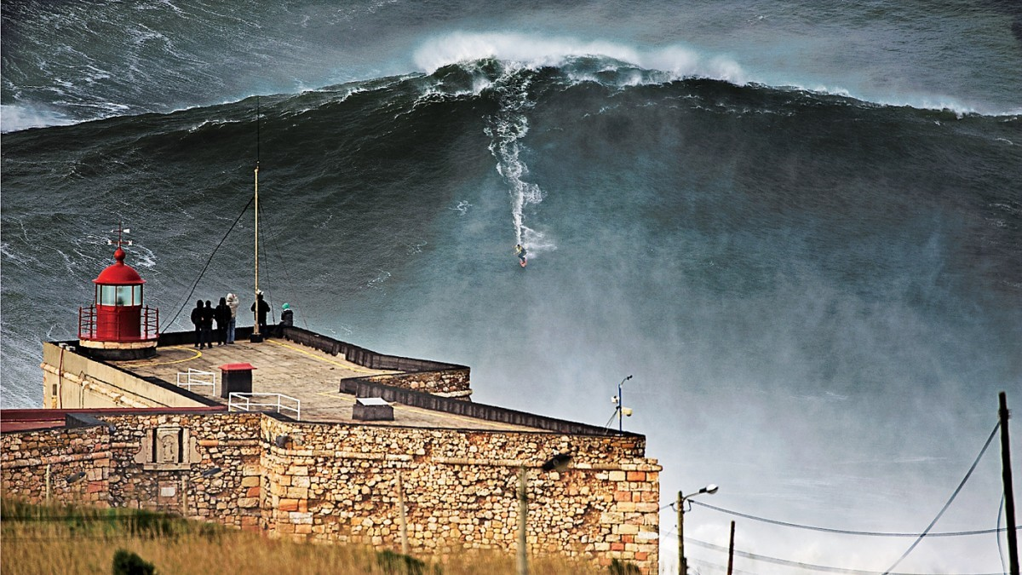

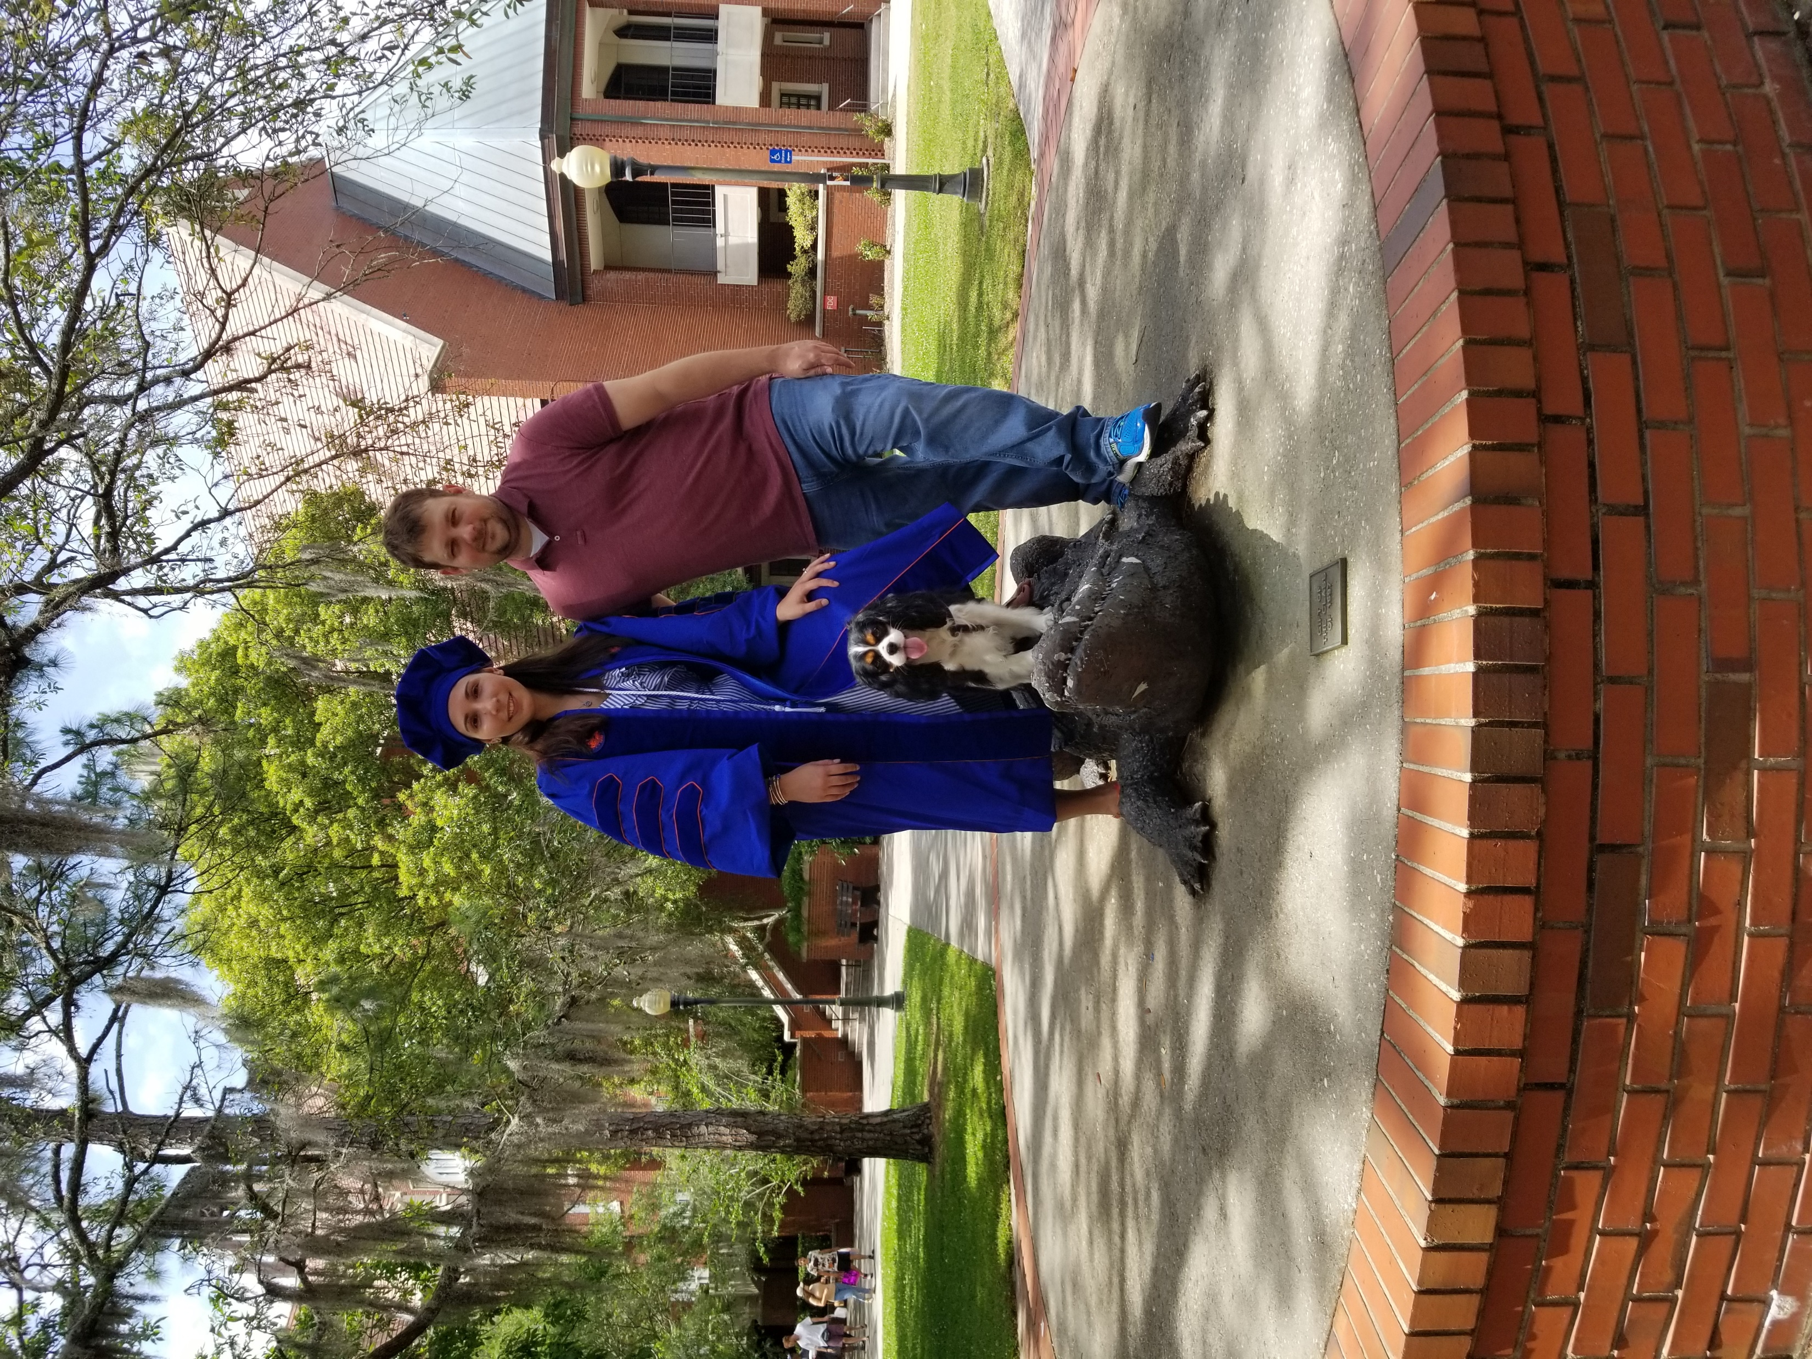

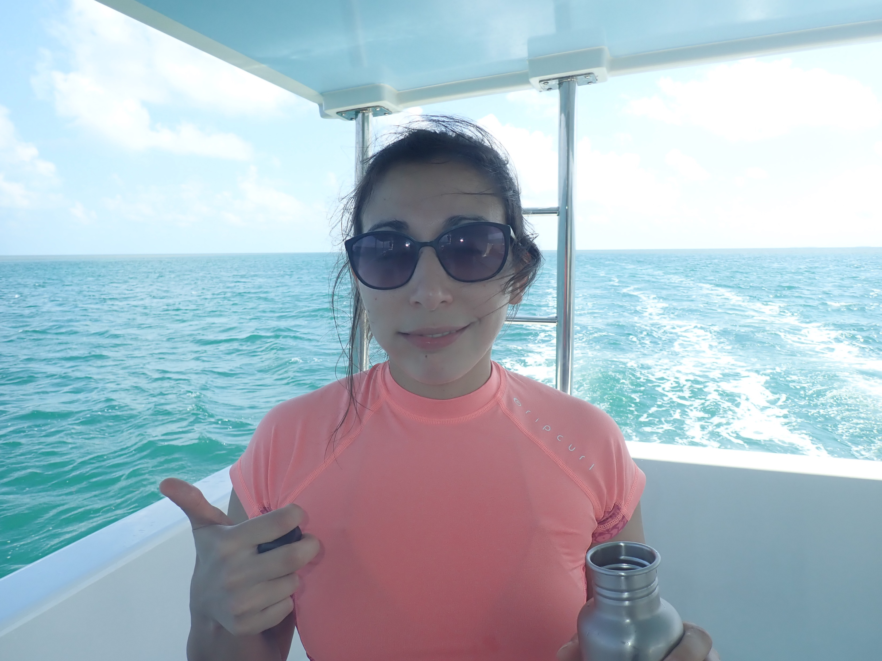
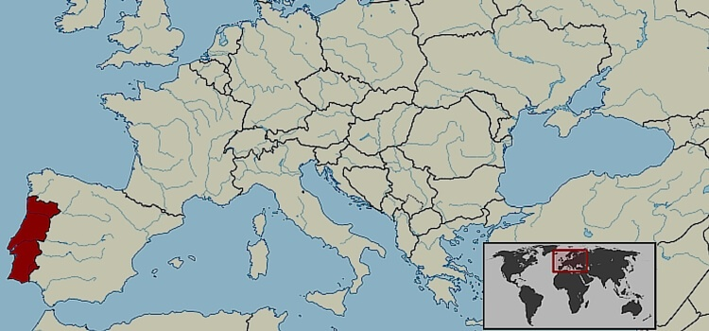
Prof. Silva
80-foot wave, Nazare
Dr. Catia Silva (KA-tee-uh SIL-vuh)
Lecturer in Electrical & Computer Engineering Department
Joined UF July 15, 2019 (2x Gator)
Conducting research in Machine Learning & Signal Processing since 2009
Conduct basic Machine Learning & Pattern Recognition Research
Driven by Application
Porto
Gainesville
Lello bookstore

Slide 5
Ying Ma

Slide 6
Pham Quan

Slide 7

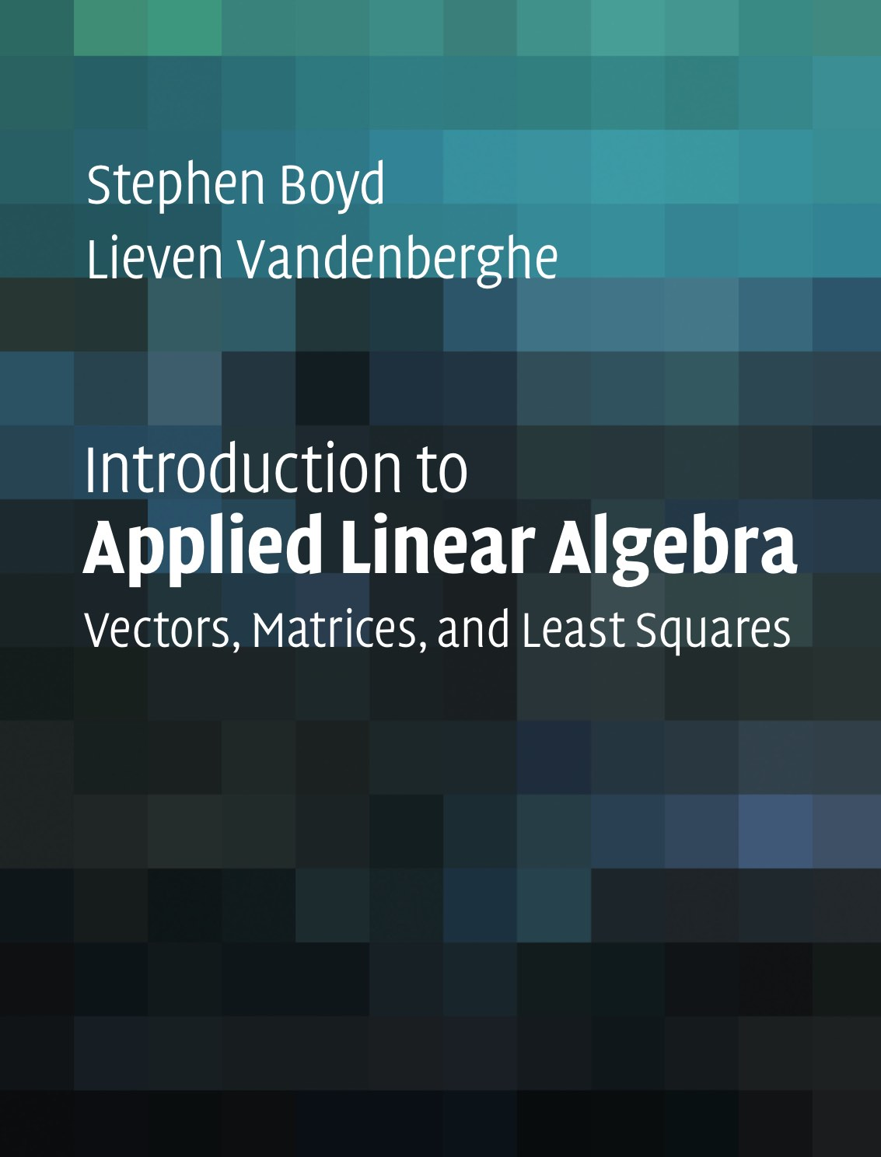




Textbooks & Software required
Title: Introduction to Probability
Author: Dimitri Bertsekas & John Tsitsiklis
Publisher: Athena Scientific
Edition: 2nd
Year: 2018
Title: Introduction to Applied Linear Algebra
Author: Stephen Boyd & Lieven Vanderberghe
Publisher: Cambridge University
Year: 2018
Title: Think Stats: Exploratory Data Analysis
Author: Allen B. Downey
Publisher: O’Reilly Media
Edition: 2nd
Year: 2014
Software:
Python 3.4.3+
Jupyter Notebook
Anaconda
PDF available here

Slide 8


Textbooks - recommended
Title: Think Bayes – Bayesian Statistics in Python
Author: Allen B. Downey
Publisher: O’Reilly Media
Year: 2013
Title: Python Data Science Handbook – Essential Tools for Working with Data
Author: Jake VanderPlas
Publisher: O’Reilly Media
Year: 2017
All required textbooks are pulled off the shelf at Marston Library.
These materials are available to EEL 4930 class only for the entire Spring 2020 semester.
Please check “Course Reserves” icon in Canvas for catalogue record.
PDF available here
e-book available here

Slide 9
Course Website: Canvas
Prerequisites
MAC 2312 (Calculus II)
Programing experience
We will be using Python
Class Meetings:
MWF 12:50 PM – 1:40 PM @ LAR 310
R 12:50 PM – 1:40 PM @ WEIL 273
Syllabus (including approximate course schedule) can be found posted in Canvas
Lecture materials and code examples presented majorly in Jupyter Notebook
Canvas page: https://ufl.instructure.com/courses/3874120

Slide 10
Grading
Percent | Grade | Grade Points
93.4 - 100 | A | 4.00
90.0 - 93.3 | A- | 3.67
86.7 - 89.9 | B+ | 3.33
83.4 - 86.6 | B | 3.00
80.0 - 83.3 | B- | 2.67
76.7 - 79.9 | C+ | 2.33
73.4 - 76.6 | C | 2.00
70.0 - 73.3 | C- | 1.67
66.7 - 69.9 | D+ | 1.33
63.4 - 66.6 | D | 1.00
60.0 - 63.3 | D- | 0.67
0 - 59.9 | E | 0.00
Grade will be based on:
Homework and projects (20%)
In-class Evaluations (10%)
Midterm Exam (30%)
Participation (10%)
Final Exam (30%)
Final grades will be curved
During the semester, we will have:
Approximately 5 Homework
Approximately 15 In-class assignments
We will provide assignment solutions

Slide 11
What is data Science?
www.wooclap.com/OCZALQ

